Slide 1
ai/o
The basics in data science

Slide 2

If you don’t enjoy… You won’t excel!

Slide 3
The team

Slide 4










Slide 5
The Platform

Slide 6
Session 1: Python essentials

Slide 7
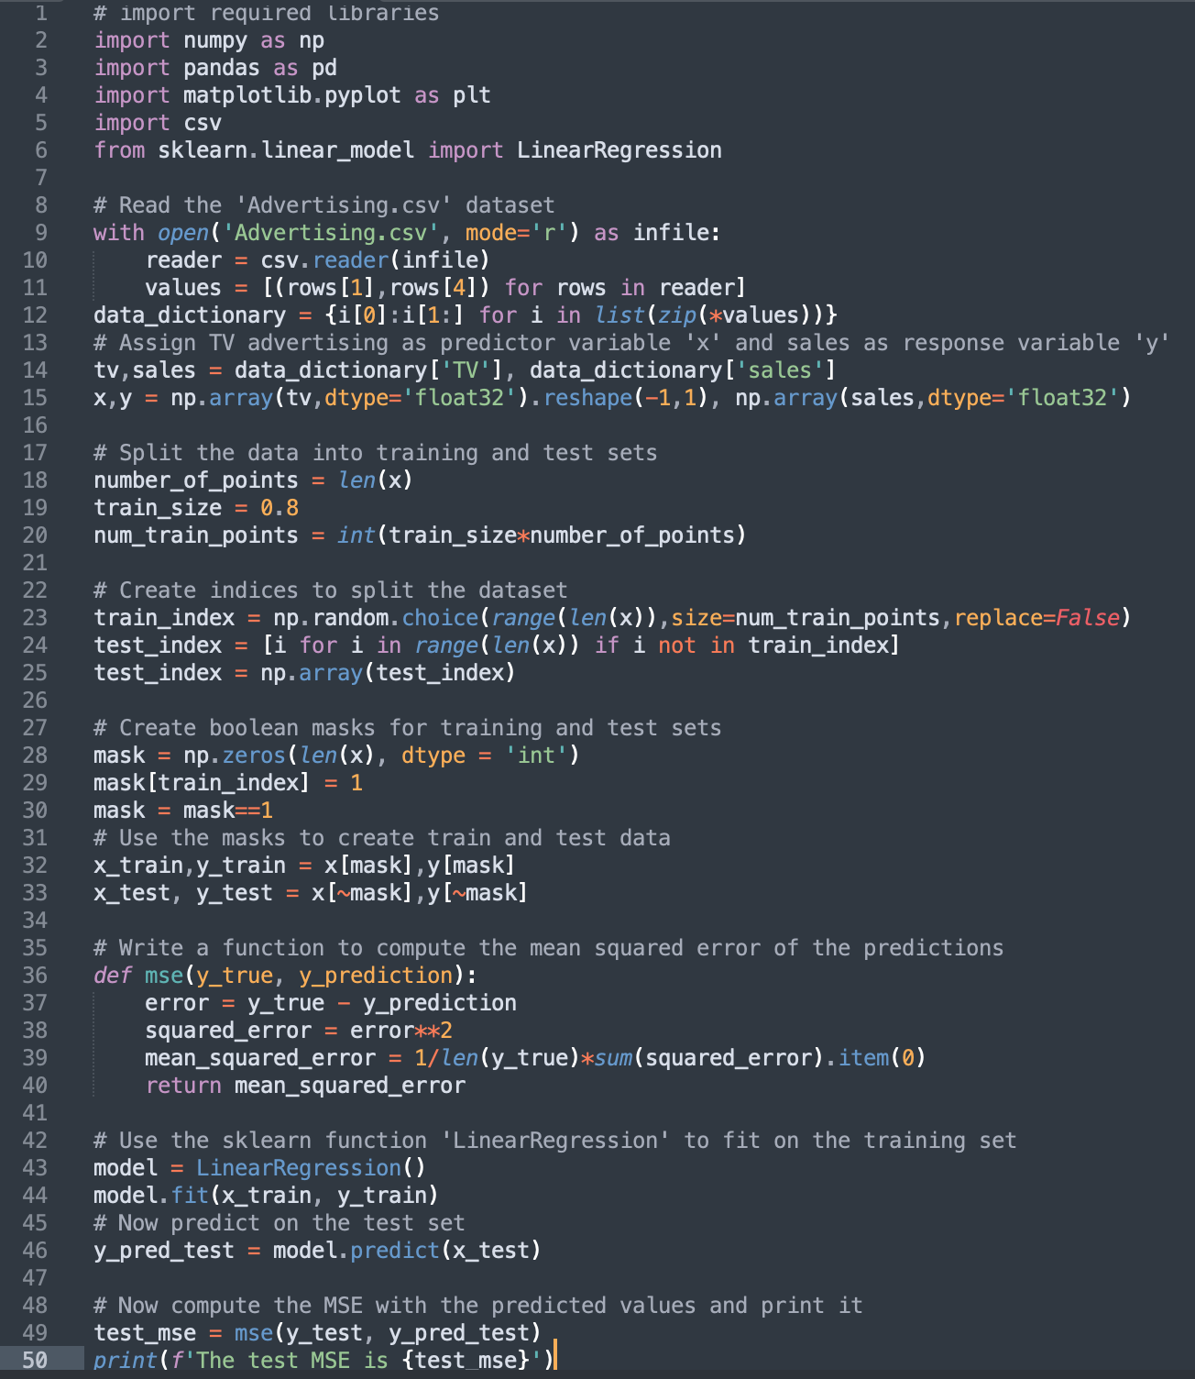
Python
Source code

Slide 8
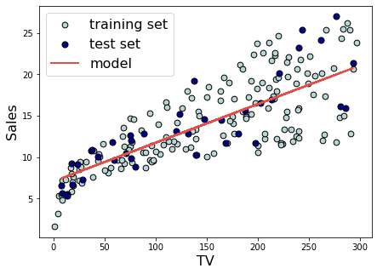

> The test MSE is 8.15
0 LOAD_NAME
2 LOAD_CONST
4 CALL_FUNCTION
6 RETURN_VALUE
PYTHON VIRTUAL MACHINE

Slide 9
Bringing it all together
Project Jupyter
IPython
In control of the user
Python Interpreter
Python Virtual Machine
Under the hood
Machine code

Slide 10
What is import ?
What is numpy ?
What is zip ?
What is with ?
What is a variable ?
What is dtype ?
What is len() ?
What is if ?
What is for ?
What is range() ?
What is train & test set ?
What is item(0) ?
What is sum ?

Slide 11
Data Types

Slide 12
Basic Data Types
3
3.14
3+4j
‘Hi!’
True
Notes:
don't explain emoji example

Slide 13
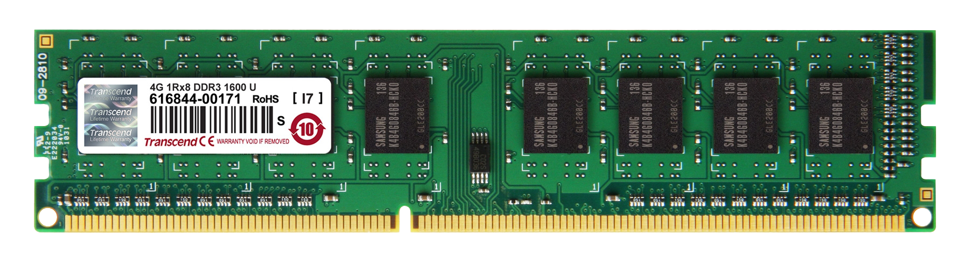
Data types

Slide 14
Variables

Slide 15
Variables

Slide 16

Variables
At your service sir
3
3.14
3+4j
H
i
!
True

Slide 17

Data types
TYPE: string
VALUE: 'hargun'
ID: 4722794

Slide 18
Type conversion
<int> → <float>
<float> → <int>
<str> → <int>
<bool> → <int>

Slide 19
Variables

Slide 20
Variables
Alfred, get me a variable called ’a’ with value as 3
Sure Master Bruce, here you go
a =3
3
3.14
a
3+4j
H
i
!
True

Slide 21
Variables
a = 10
b = 10
c = a
10

Slide 22
Operators

Slide 23
Arithmetic operators
+ - * /

Slide 24
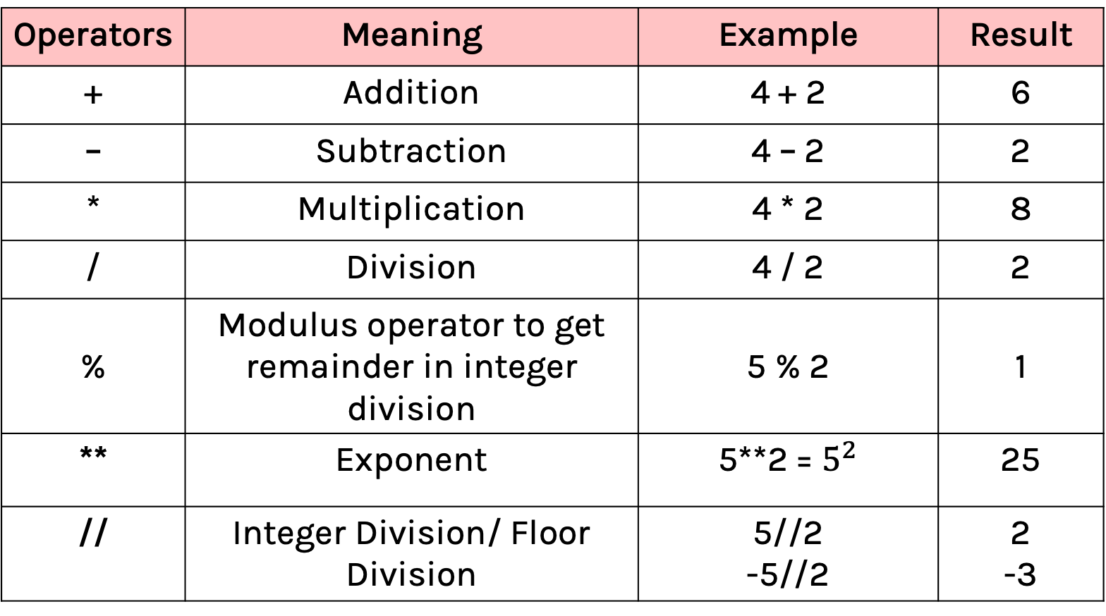
Arithmetic operators
Operators | Meaning | Example | Result
+ | Addition | 4 + 2 | 6
– | Subtraction | 4 – 2 | 2
* | Multiplication | 4 * 2 | 8
/ | Division | 4 / 2 | 2
% | Modulus operator to get remainder in integer division | 5 % 2 | 1
** | Exponent | 5**2 = $5^{2}$ | 25
// | Integer Division/ Floor Division | 5//2 -5//2 | 2 -3

Slide 25
Comparison operators
> <
==
!=

Slide 26
Comparison operators
Operators | Meaning | Example | Result
< | Less than | 5<2 | False
> | Greater than | 5>2 | True
<= | Less than or equal to | 5<=2 | False
>= | Greater than or equal to | 5>=2 | True
== | Equal to | 5==2 | False
!= | Not equal to | 5!=2 | True

Slide 27
Comparison vs Assignment
assigment operator – used to assign values to variables
=
v/s
==
Operator to check if two values are equal or not

Slide 28
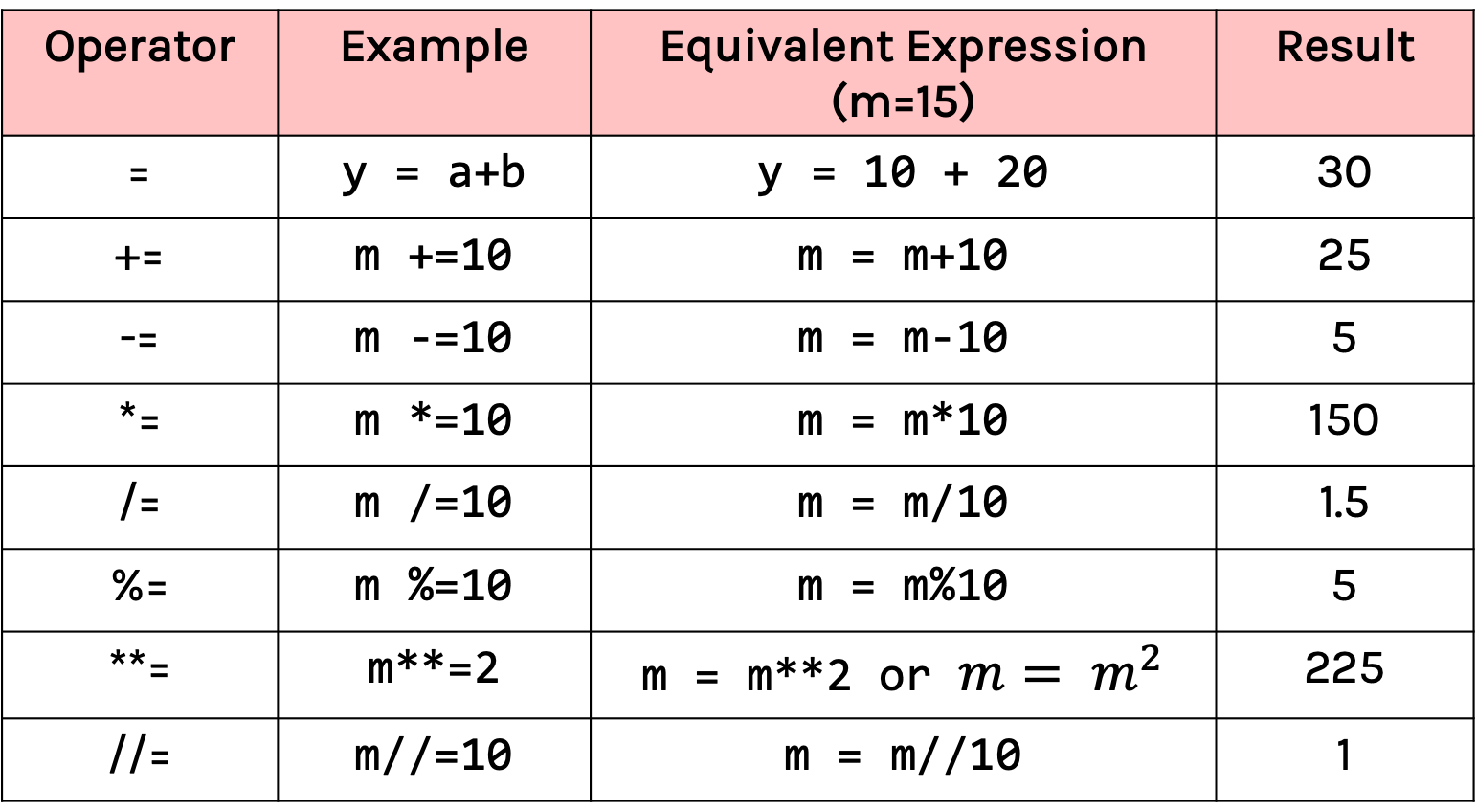
Assignment Operators
Operator | Example | Equivalent Expression (m=15) | Result
= | y = a+b | y = 10 + 20 | 30
+= | m +=10 | m = m+10 | 25
-= | m -=10 | m = m-10 | 5
*= | m *=10 | m = m*10 | 150
/= | m /=10 | m = m/10 | 1.5
%= | m %=10 | m = m%10 | 5
**= | m**=2 | m = m**2 or $m= m^{2}$ | 225
//= | m//=10 | m = m//10 | 1

Slide 29
Logical operators
and
or
not

Slide 30
Conditional operators
Logical Operators
Don't forget the parenthesis between the conditions
Operator | Meaning | Example | Result
and | Logical and | (5<2) and (5>3) | False
or | Logical or | (5<2) or (5>3) | True
not | Logical not | not (5<2) | True
Notes:
explain example where parenthesis breaks

Slide 31
Flow control

Slide 32
If... Else block
if (condition):
statement1
statement2
else:
statement3
Rest of the Code
....
....
....
Notes:
indentation error if khichdi

Slide 33


Slide 34


Slide 35
Lists

Slide 36
Basic Data Types
3
3.14
3+4j
‘Hi!’
True
Notes:
don't explain emoji example

Slide 37
Lists
[
3
,
,
,
,
‘Hi!’
True
3+4j
3.14
[
Notes:
don't explain emoji example

Slide 38
List access
[
3
,
,
harlist =
3
‘Hi!’
,
,
‘Hi!’
3.14
True
[
3.14
3+4j

Slide 39
List indexing

Slide 40
List access
[
3
,
,
harlist =
3
‘Hi!’
,
,
‘Hi!’
3.14
True
[
3.14
3+4j
Harlist[0]

Slide 41
List access
[
3
,
,
,
harlist =
‘Hi!’
,
‘Hi!’
3.14
True
[
3.14
3+4j
3
Harlist[0]
Notes:
That’s why it’s called AI-0

Slide 42
List access
[
3
,
,
harlist =
3
‘Hi!’
,
,
‘Hi!’
3.14
True
[
3.14
3+4j
Harlist[1]

Slide 43
List access
[
3
,
,
harlist =
3
‘Hi!’
,
,
3.14
True
[
3.14
3+4j
‘Hi!’
Harlist[1]

Slide 44
List access
[
3
,
,
harlist =
3
‘Hi!’
,
,
‘Hi!’
True
[
3.14
3+4j
3.14
3+4j
Harlist[-1]

Slide 45
List access
[
3
,
,
harlist =
3
‘Hi!’
,
,
3.14
True
[
3.14
3+4j
3+4j
Harlist[-1]

Slide 46

List slicing

Slide 47
List Indexing
List[start:stop:(Optional)step]
Notes:
difference between [::-1] and [0:4:-1]

Slide 48
List Slicing
0 1 2 3 4 5 6
# Make a list of fruits
>>> fruits = ['tangerine', 'apple', 'pear', 'banana', 'kiwi', 'apple', 'banana']
🍊
🍎
🍐
🍌
🥝
🍎
🍌
-7 -6 -5 -4 -3 -2 -1
fruits[0:4] =
🍊
🍎
🍐
🍌

Slide 49
List methods

Slide 50
List methods – append()
# Make a list of fruits
>>> fruits = ['tangerine', 'apple', 'pear', 'banana', 'kiwi', 'apple', 'banana']
>>> fruits.append('grape')
>>> fruits
['tangerine', 'apple', 'pear', 'banana', 'kiwi', 'apple', 'banana', 'grape']
🍊
🍏
🍐
🍌
🥝
🍎
🍌
🍇

Slide 51
Many more methods …
>>> fruits = ['tangerine', 'apple', 'pear', 'banana', 'kiwi', 'apple', 'banana']
>>> fruits.count('apple')
2
>>> fruits.count('tangerine')
1
>>> fruits.index('banana')
3
>>> fruits.index('banana', 4) # Find next banana starting a position 4
6
>>> fruits.reverse()
>>> fruits
['banana', 'apple', 'kiwi', 'banana', 'pear', 'apple', 'tangerine']
>>> fruits.append('grape')
>>> fruits
['banana', 'apple', 'kiwi', 'banana', 'pear', 'apple', 'tangerine', 'grape']
>>> fruits.sort()
>>> fruits
['apple', 'apple', 'banana', 'banana', 'grape', 'kiwi', 'pear', 'tangerine']
>>> fruits.pop()
'tangerine'

Slide 52
Python built-in functions?

Slide 53
Built-in method – Sum()
sum(
)
0 | 1 | 2 | 3 | 4 | 5 | 6 | 7 | 8 | 9
45

Slide 54
Range Function

Slide 55
Range function
range[start,stop,(Optional)step]

Slide 56
What does 'Mutable' mean ?

Slide 57
List Aliasing
Aliasing means giving another name to the existing object. It doesn’t mean copying.
a = [10, 20, 30, 40, 50]
b = a
Modification in a will affect b and vice versa.
a
10 | 20 | 30 | 40 | 50
[0] | [1] | [2] | [3] | [4]
b

Slide 58
Copy a list
When we copy a list a separate copy of all the elements is stored in another list. Both the lists are independent.
a = [10, 20, 30, 40, 50]
b = a.copy()
Modification in a will not affect b and vice versa.
a
10 | 20 | 30 | 40 | 50
[0] | [1] | [2] | [3] | [4]
b
10 | 20 | 30 | 40 | 50

Slide 59
Strings

Slide 60
String Literals
What is a python string ?
"Hello, World!"
'83110 7O510'
'' 👋🏻 🌍 ''

Slide 61

String Literals
Collection of characters (including emojis).
Starts and ends with either double quotes or single quotes or even triple quotes.
Like tuples, it can't be modified after initialization.
option_1 = 'Hello, World!'
option_2 = "Hello, World!"
option_3 = '''
........ Hello,
........ World!
'''

Slide 62
String Literals
Collection of characters (including emojis)
Starts and ends with either double quotes or single quotes or even triple quotes
Like tuples, it can't be modified after initialization
option_1 = 'Hello, World!'
option_2 = "Hello, World!"
option_3 = '''
........ Hello,
........ World!
'''

Slide 63
Tripping over quotes
In [13]: print('Say hi to my 'friend'')
File "<ipython-input-13-7108e0539fd5>", line 1
print('Say hi to my 'friend')
^
SyntaxError: invalid syntax
backslash (\) is an escape character. We will see more of it in later sessions
print('Say hi to my "friend"')
>>> Say hi to my "friend"
print('Say hi to my \'friend\'')
>>> Say hi to my 'friend'

Slide 64
String operations
"Hello" + " World!" = "Hello World!"
The in operator can be used to check for an exact match of a string in another string
"Hello" in "Hello World!"
>>> True
"hello" in "Hello World!"
>>> False

Slide 65
Accessing a string
0 1 2 3 4 5 6
Strings can be indexed just like lists.
Using this we can use them in loops
🍊
🍎
🍐
🍌
🥝
🍎
🍌
-7 -6 -5 -4 -3 -2 -1
0 1 2 3 4 5 6 7 8 9 10
h | e | l | l | o |  | w | o | r | l | d
-11 -10 -9 -8 -7 -6 -5 -4 -3 -2 -1

Slide 66
Tuples in Python
Tuple = (e₁, e₂…e_{N})
Notes:
Tuples – Motivating example

Slide 67

Tuples in Python
Type of the Variable
In [7]: a = (2,3)
In [8]: b = (2)
In [9]: c = ('string')
In [10]: d = (2,)
In [11]: e,f = 2,3
Type(a) - tuple
Type(b) - integer
Type(c) - string
Type(d) - tuple
Type(e) - integer
Type(f) – integer
List of tuple methods here

Slide 68
What is import ?
What is numpy ?
What is zip ?
What is with ?
What is a variable ?
What is dtype ?
What is len() ?
What is if ?
What is for ?
What is range() ?
What is train & test set ?
What is item(0) ?
What is sum ?

